Slide 1
Testbed for Surface Detection with Ultrasound Responsible Professor : Univ.-Prof. Dr.-Ing. Giovanni Del Galdo Supervisors : Dr.-Ing Florian Roemer, M.Sc. Eduardo Perez Mejia

Slide 2
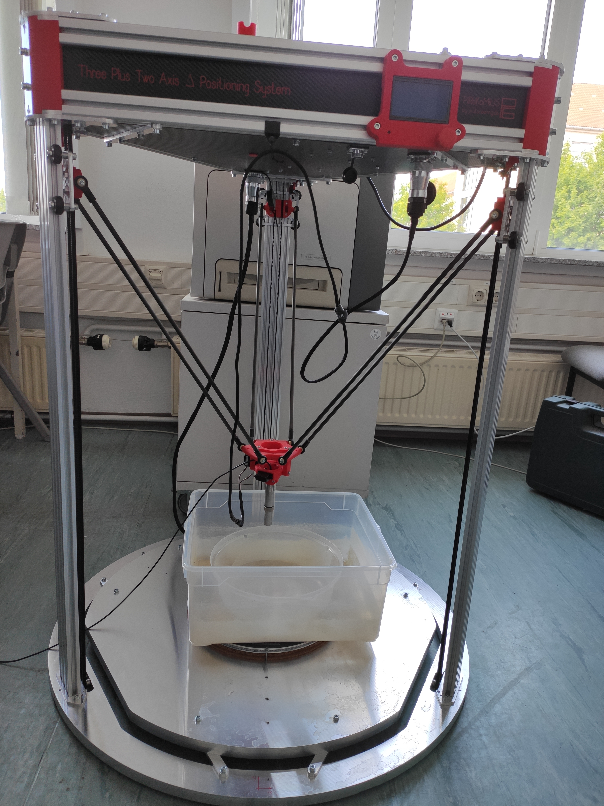
Ultrasound NDT Setup
Robotic Positioning System
Controlling position and angle
Measurement Collection
Detection of surface
Transducer
Specimen

Slide 3
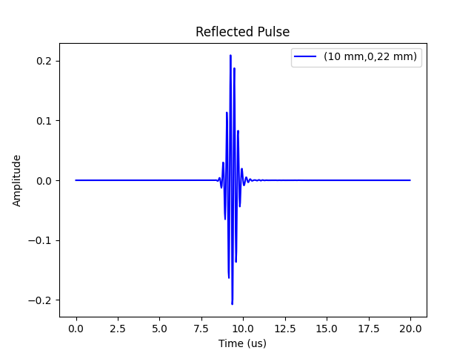
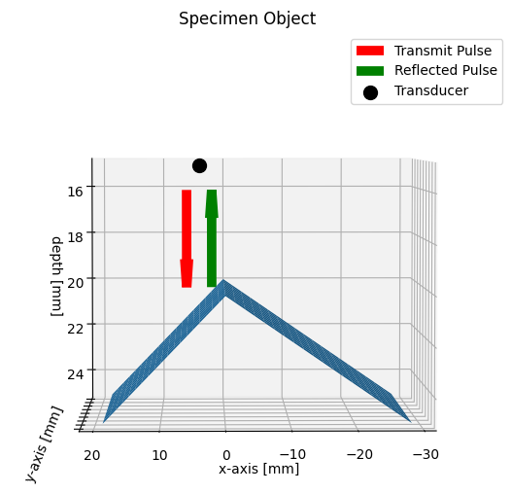
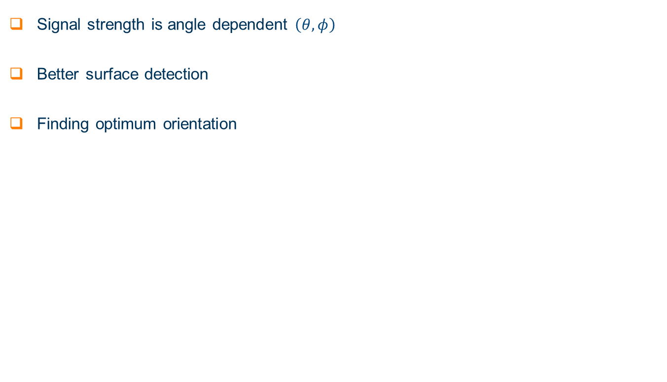
Measurement Setup
Signal strength is angle dependent $\left(θ,φ\right)$
Better surface detection
Finding optimum orientation

Slide 4
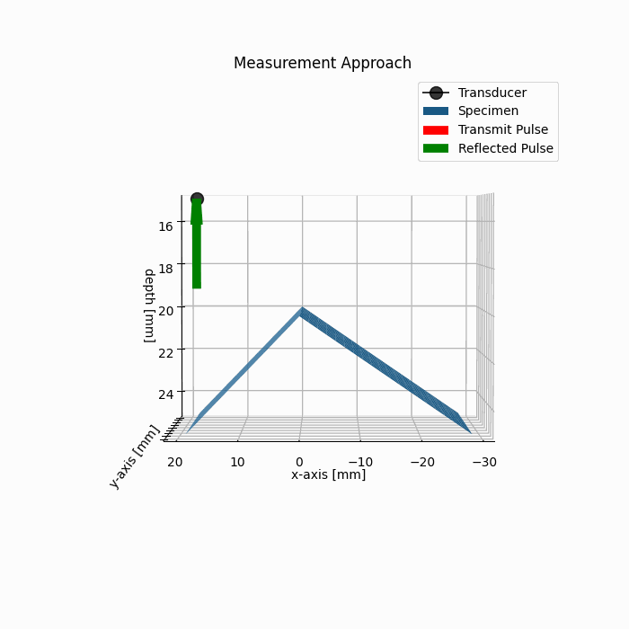
Motivation
No feedback from positioning system
Latency in measurement collection
Slow calibration testing
Dependency on hardware

Slide 5
Introduction
Faster prototyping of calibration methods
Removal of hardware dependency
Virtual Calibration Platform
Virtual Measurement setup
Calibration Algorithms
Ray Tracing Model
Stochastic Approximation

Slide 6
Introduction
Emulate measurement operation.
Stochastic Approximation performs calibration.
Independent sections working together.
Measurement data (A - Scan)
Ray Tracer Model
Stochastic Approximation
Input arguments (x, y, z coordinates of measurement point)
Geometry
Transducer model
Configuration
Initialize virtual setup
Initialize algorithms
Execution

Slide 7
Ray tracer : Introduction
Ray Tracer : Overview
Building Blocks
Assumptions
Advantages
Transducer
Pulse shaper
Transducer :
Pin hole camera model
Specimen objects
Pulse Shaper:
Choice of pulse shape
Modulation of carrier
Frequency of operation
Medium is homogeneous
Wavefields as rays
Convex shape objects
Simplifies Wave propagation
Less computational cost
Faster measurements.

Slide 8
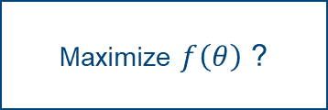
Stochastic Approximation : Introduction
Fewer measurements compared to current approach
Automate calibration process
Performance can be optimized
Maximize $f\left(θ\right)$ ?
Function itself is unknown.
Estimate parameters in less time and high accuracy.
Only few measurements are available.

Slide 9
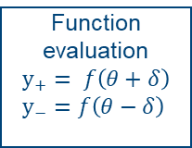
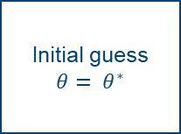
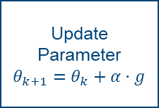
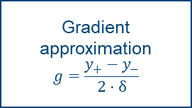
Stochastic Approximation : Introduction
Methods are iterative
Gradient is approximated
Parameter is updated according to the gradient
Process above is repeated until convergence
Estimated parameter and true solution are compared
Initial guess
$$θ= θ^{∗}$$
Function evaluation
$y_{+}= f\left(θ+δ\right)$
$y_{−}=f\left(θ−δ\right)$
Gradient approximation
$$g=\frac{y_{+}−y_{−}}{2⋅δ}$$
Update Parameter
$θ_{k+1}=θ_{k}+α⋅g$

Slide 10
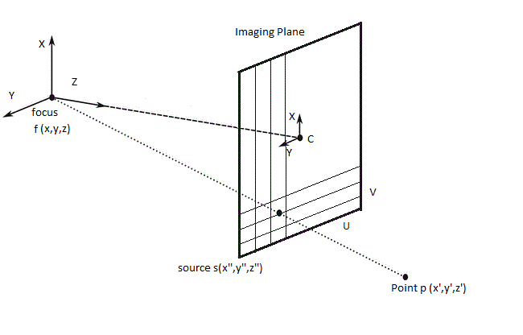
Ray Tracer Model
Transducer :
Imaging Plane depicts sensor area
Plane is discretized into pixels
Wavefields impinging are treated as rays
Each pixel is associated with a ray
Imaging Plane
focus

Slide 11
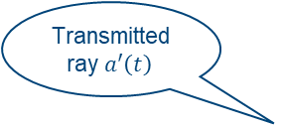
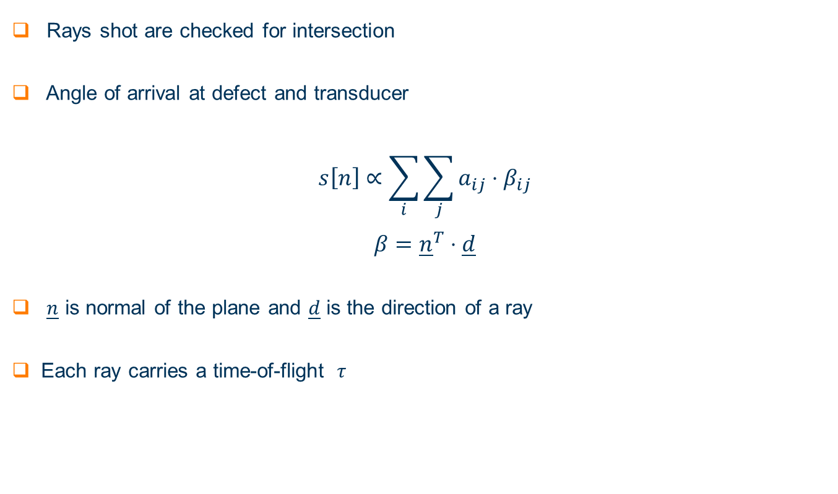
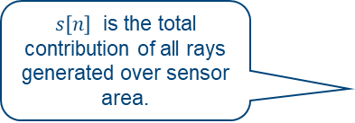
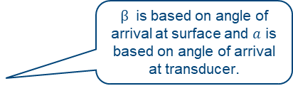
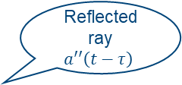
Ray Tracer Model
Rays shot are checked for intersection
Angle of arrival at defect and transducer
$$s\left[n\right]∝\sum_{i}{\sum_{j}{a_{ij}}}⋅β_{ij}$$
$$β={\underline{n}}^{T}⋅\underline{d}$$
$\underline{n}$ is normal of the plane and $\underline{d}$ is the direction of a ray
Each ray carries a time-of-flight $τ$
$β$ is based on angle of arrival at surface and $a$ is based on angle of arrival at transducer.
$s\left[n\right]$ is the total contribution of all rays generated over sensor area.
Transmitted ray $a′\left(t\right)$
Source
Reflected ray $a′′\left(t−τ\right)$
Surface

Slide 12
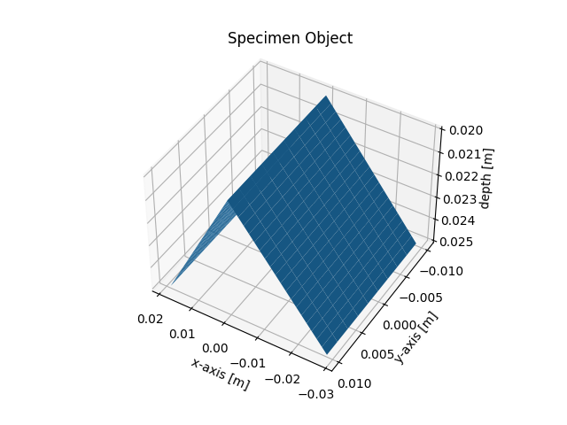
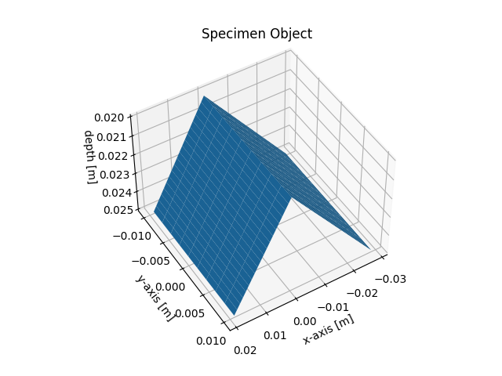
Ray Tracer Model
Specimen Object :
Required to simulate measurement operation
Planes are used to build a specimen
Orientation of object is unknown

Slide 13
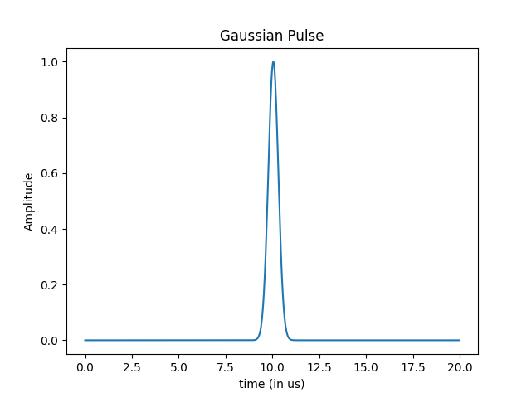
Ray Tracer
Pulse Shaper :
Choice of transmit pulse is often not programmable
Set of pulse shapes are implemented
Parameters of each pulse are programmable
Calibration performance is tested with each pulse shape
Parameter | Value
Bandwidth Factor | 0.7e13
Sampling Frequency | 40 MHz
Center Frequency | 3 MHz

Slide 14
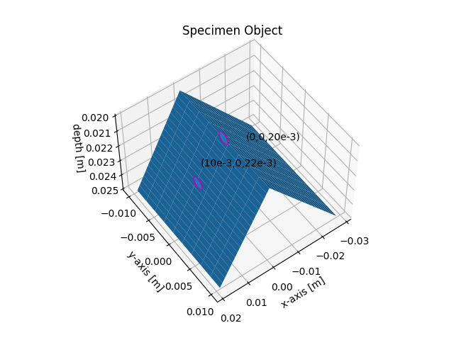
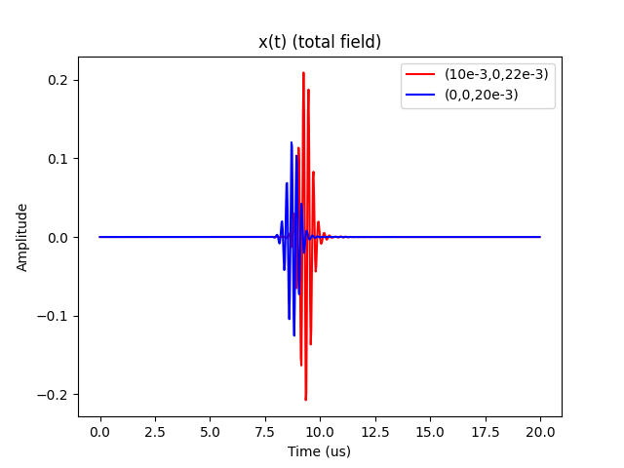
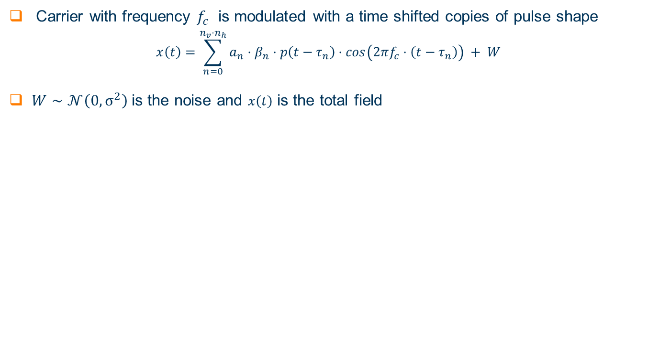
Pulse Shaper
Carrier with frequency $f_{c}$ is modulated with a time shifted copies of pulse shape
$$x\left(t\right)=\sum_{n=0}^{n_{v}⋅n_{h}}{a_{n}}⋅β_{n}⋅p\left(t−τ_{n}\right)⋅\cos\left(2πf_{c}⋅\left(t−τ_{n}\right)\right) + W$$
$W∼𝒩\left(0,σ^{2}\right)$is the noise and $x\left(t\right)$ is the total field

Slide 15
Stochastic Approximation
Methods are analysed based on following factors
Function evaluations per Iteration
Computational Complexity
Factors affecting convergence behaviour
Stability of algorithm
Accuracy : Difference between estimated and true solution
Performance optimization
Inter algorithm performance comparison
Algorithms use the virtual data

Slide 16
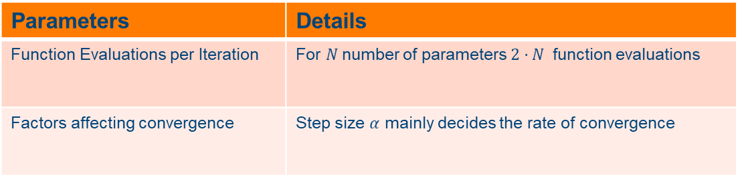
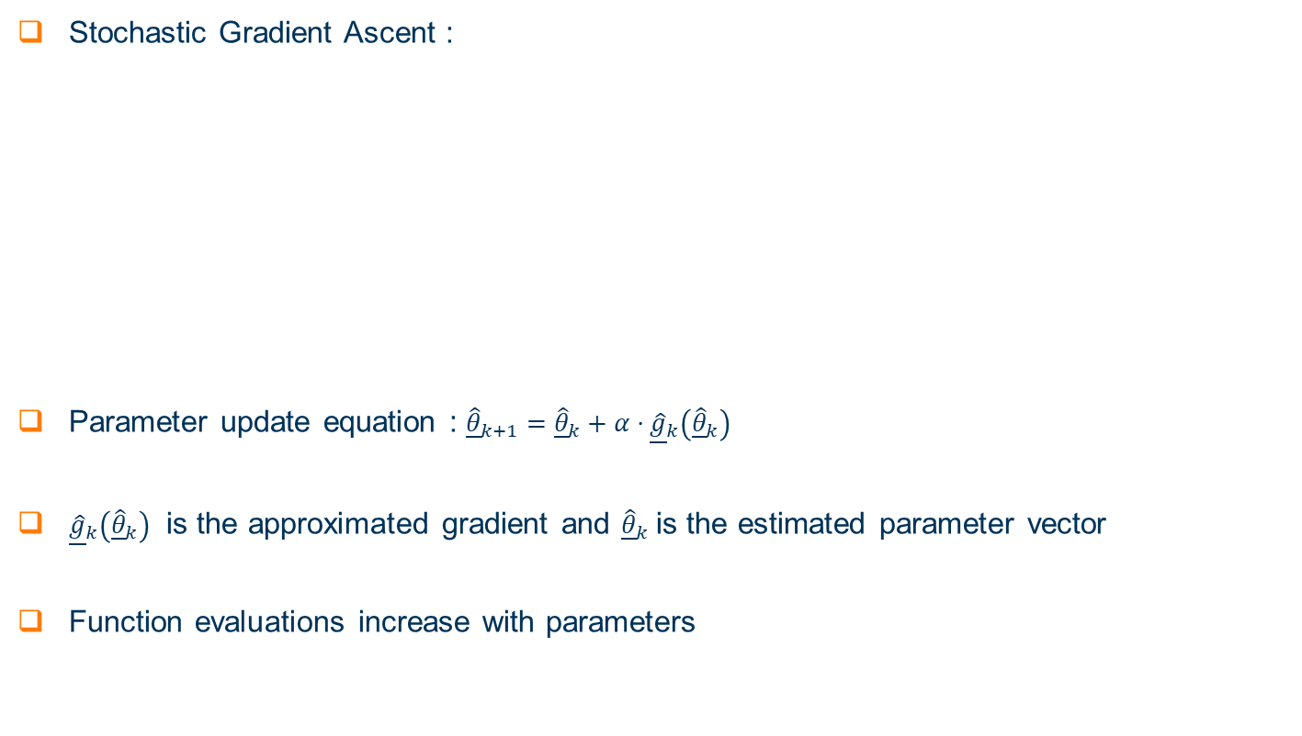
Stochastic Approximation : Stochastic Gradient Ascent
Stochastic Gradient Ascent :
Parameter update equation : ${\underline{\hat{θ}}}_{k+1}={\underline{\hat{θ}}}_{k}+α⋅{\underline{\hat{g}}}_{k}\left({\underline{\hat{θ}}}_{k}\right)$
${\underline{\hat{g}}}_{k}\left({\underline{\hat{θ}}}_{k}\right)$ is the approximated gradient and ${\underline{\hat{θ}}}_{k}$ is the estimated parameter vector
Function evaluations increase with parameters
Parameters | Details
Function Evaluations per Iteration | For $N$number of parameters $2⋅N$ function evaluations
Factors affecting convergence | Step size $α$ mainly decides the rate of convergence

Slide 17
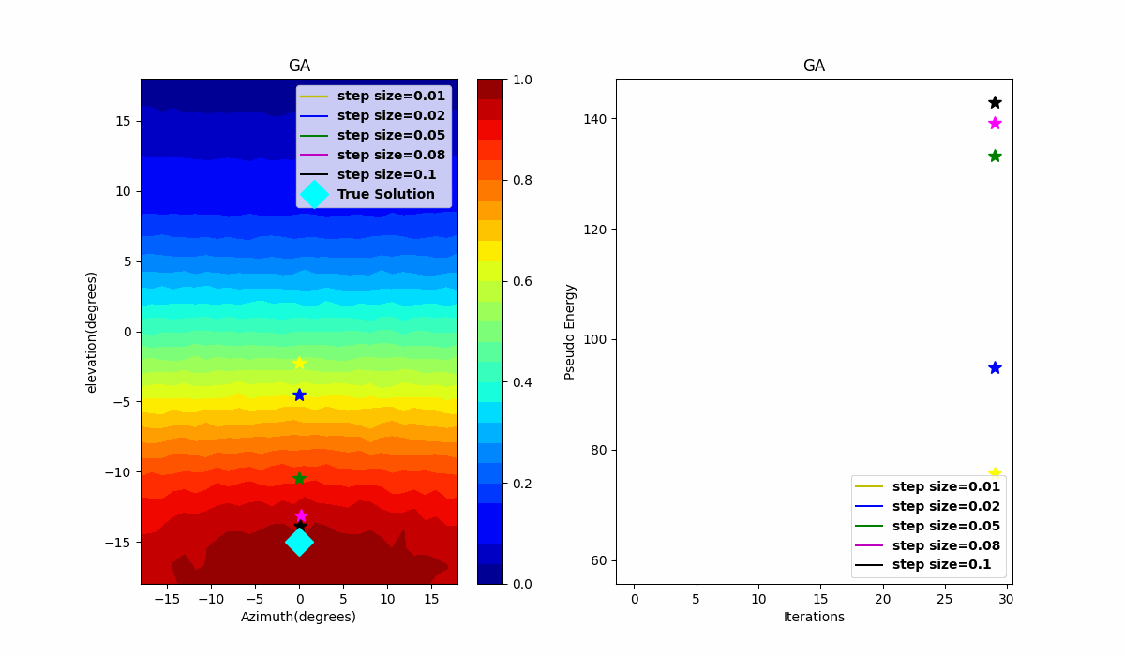
Stochastic Approximation : Stochastic Gradient Ascent
Effect of Step size on Convergence
Different Step sizes are configured
Parameter | Values
SNR | 20 dB
Initial guess azimuth | 0
Initial guess elevation | 0
Iterations | 30

Slide 18
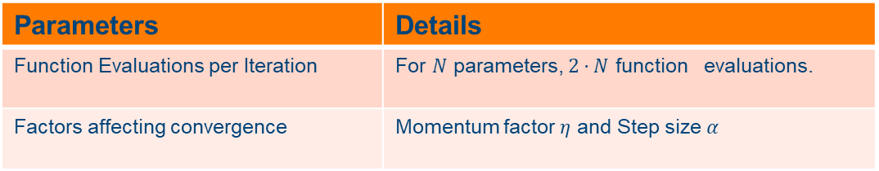
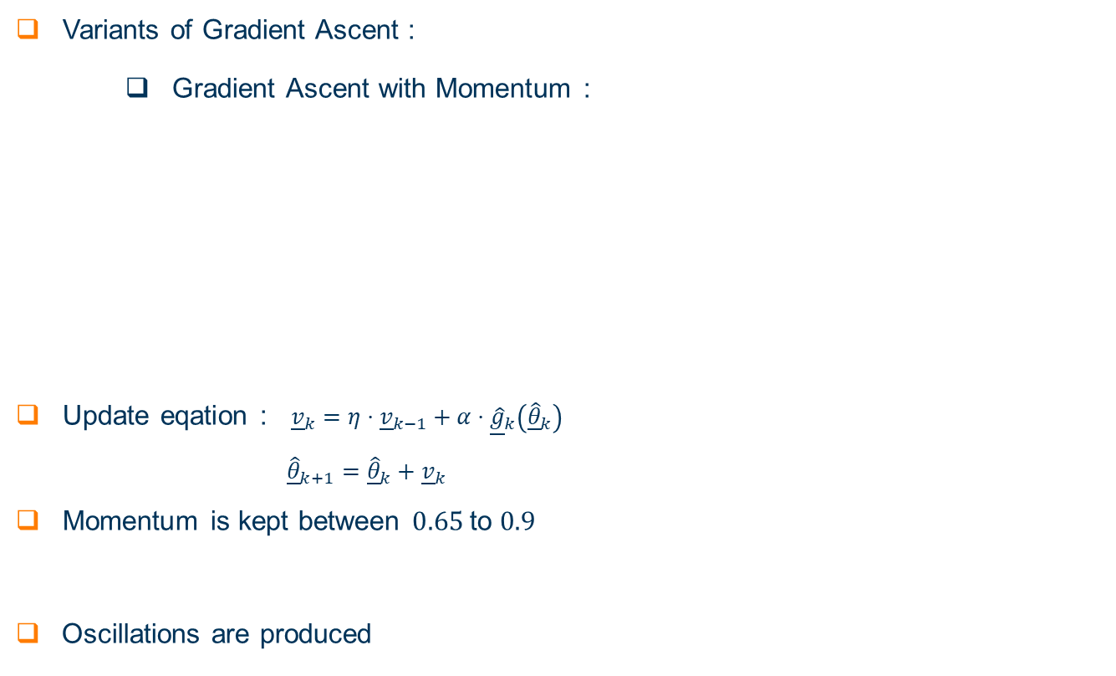
Stochastic Approximation : Variants of Gradient Ascent
Variants of Gradient Ascent :
Gradient Ascent with Momentum :
Update eqation : ${\underline{v}}_{k}=η⋅{\underline{v}}_{k−1}+α⋅{\underline{\hat{g}}}_{k}\left({\underline{\hat{θ}}}_{k}\right)$
${\underline{\hat{θ}}}_{k+1}={\underline{\hat{θ}}}_{k}+{\underline{v}}_{k}$
Momentum is kept between $0.65$ to $0.9$
Oscillations are produced
Parameters | Details
Function Evaluations per Iteration | For $N$ parameters, $2⋅N$ function evaluations.
Factors affecting convergence | Momentum factor $η$ and Step size $α$

Slide 19
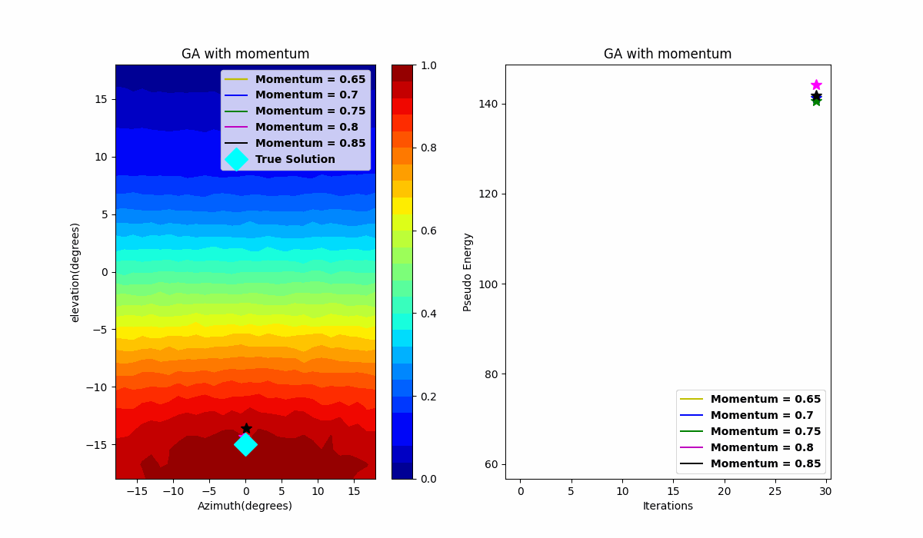
Stochastic Approximation : Variants of Gradient Ascent
Momentum factor on Convergence behavior.
Faster convergence
Oscillations produced for high momentum
Parameter | Values
SNR | 20 dB
Step size | 0.05
Initial guess azimuth | 0
Initial guess elevation | 0
Iterations | 30

Slide 20
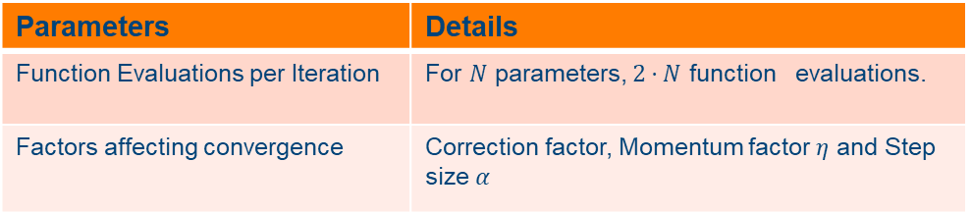
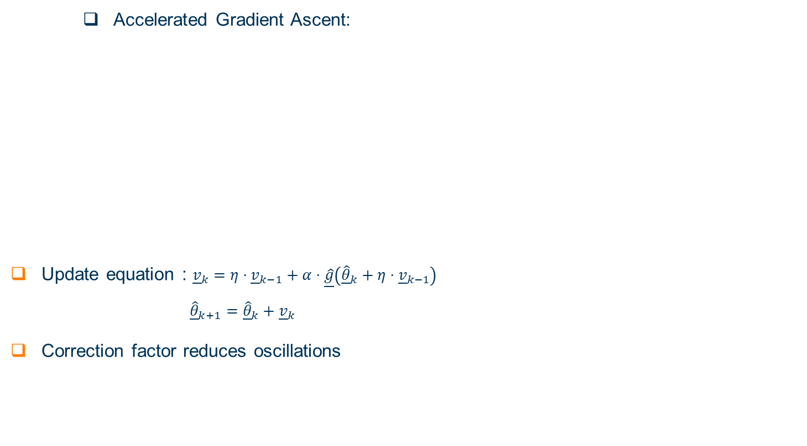
Stochastic Approximation : Variants of Gradient Ascent
Accelerated Gradient Ascent:
Update equation : ${\underline{v}}_{k}=η⋅{\underline{v}}_{k−1}+α⋅\underline{\hat{g}}\left({\underline{\hat{θ}}}_{k}+η⋅{\underline{v}}_{k−1}\right)$
${\underline{\hat{θ}}}_{k+1}={\underline{\hat{θ}}}_{k}+{\underline{v}}_{k}$
Correction factor reduces oscillations
Parameters | Details
Function Evaluations per Iteration | For $N$ parameters, $2⋅N$ function evaluations.
Factors affecting convergence | Correction factor, Momentum factor $η$ and Step size $α$

Slide 21

Stochastic Approximation : Variants of Gradient Ascent
Important to observe the effect of correction factor.
Reduced oscillations
Correction factor important for high momentum values
Parameter | Values
SNR | 20 dB
Step size | 0.05
Initial guess azimuth | 0
Initial guess elevation | 0
Iterations | 30

Slide 22
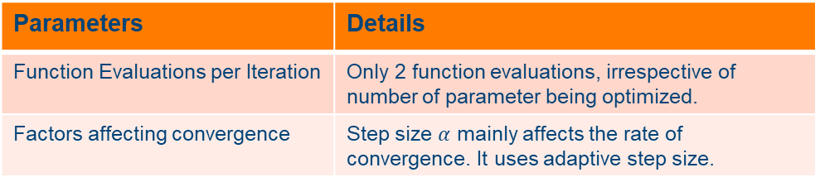
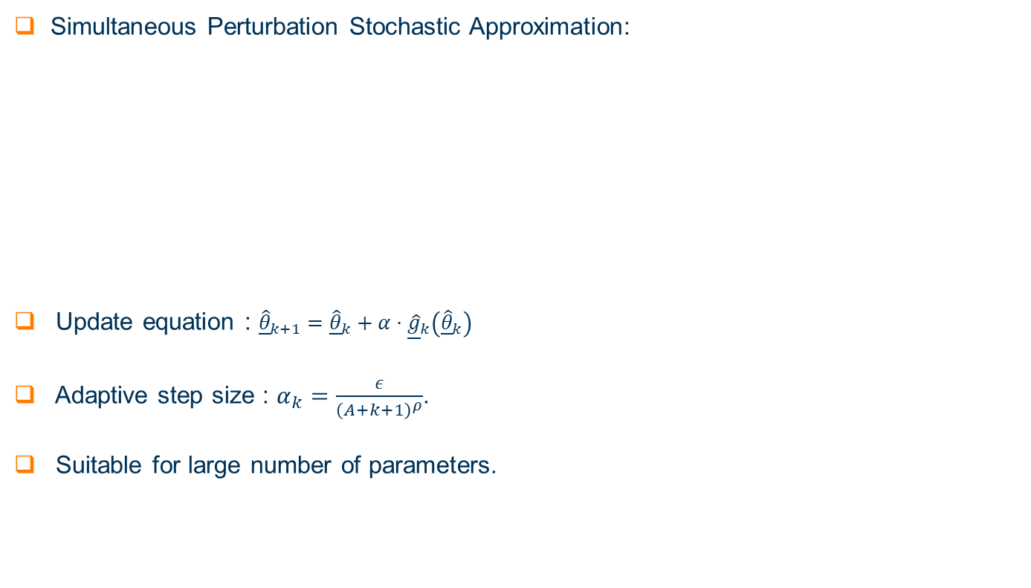
Stochastic Approximation : SPSA
Simultaneous Perturbation Stochastic Approximation:
Update equation : ${\underline{\hat{θ}}}_{k+1}={\underline{\hat{θ}}}_{k}+α⋅{\underline{\hat{g}}}_{k}\left({\underline{\hat{θ}}}_{k}\right)$
Adaptive step size : $α_{k}=\frac{ε}{{\left(A+k+1\right)}^{ρ}}$.
Suitable for large number of parameters.
Parameters | Details
Function Evaluations per Iteration | Only 2 function evaluations, irrespective of number of parameter being optimized.
Factors affecting convergence | Step size $α$ mainly affects the rate of convergence. It uses adaptive step size.
Parameter | Value
Initial guess azimuth | 0
Initial guess elevation | 0
Iterations | 30

Slide 23
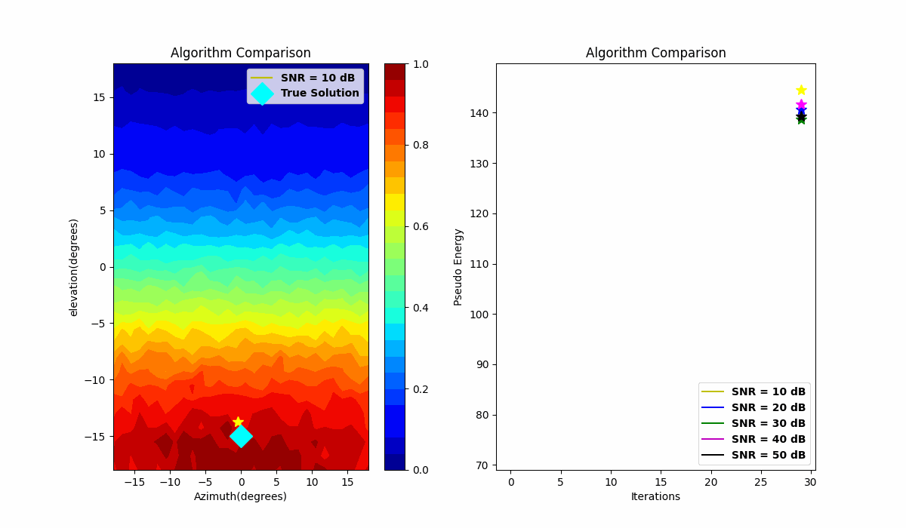
Stochastic Approximation : SPSA
Stability of Algorithm is tested

Slide 24
Stochastic Approximation : Algorithm Performance Comparison
Test scenario is configured
Performance Comparison
Iterations required
Function evaluations
Accuracy
Stability
Suitability for real world testing
Test Scenario
Parameter | Values
SNR | 20 dB
Step size | 0.05
Initial guess azimuth | 0
Initial guess elevation | 0
Iterations | 30

Slide 25
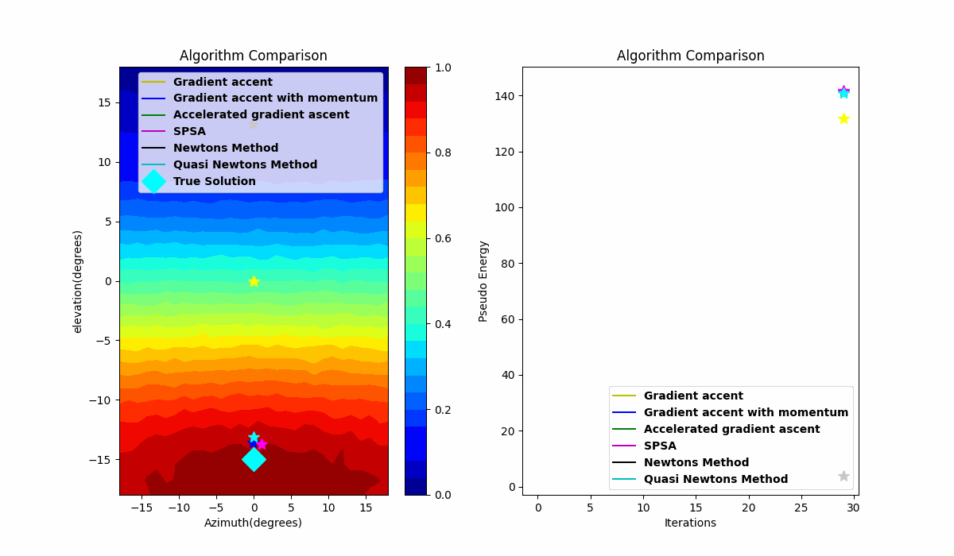
Stochastic Approximation : Algorithm Performance Comparison

Slide 26
Algorithm Performance Comparison : Summary
Performance analysis
Experiment is run for 30 Iterations.
For Current experiment
 | Function Evaluations/Iteration | Total Function Evaluations
Gradient Ascent | 4 | 120
Gradient Ascent with momentum | 4 | 120
Accelerated Gradient Ascent | 4 | 120
SPSA | 2 | 60
Newton’s Method | 9 | 270
Quasi Newton’s Method | 4 | 120

Slide 27
Summary and Contribution
Useful prior to real world testing
Faster prototyping
Virtual Calibration Platform
Programmability of Parameters
Removal of hardware dependency
Automation of Calibration process

Slide 28
Conclusion
Alternative to hardware-based calibration
Independent Components working together
Automation of calibration
Optimization of performance
Limitations of measurement model

Slide 29
Thank you !!!
Questions

Slide 30
Extra Slides

Slide 31
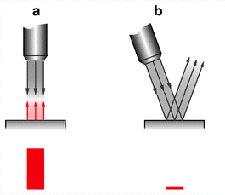
Problem Description
Goal is to identify and localize defects.
Strength of reflected signal is angle dependent.
Transmit pulse must be shot at an optimum angle.
Robotic Positioner (Holding Transducer)
Position and orientation of transducer is controlled.
Transmit Pulse
Reflected Signal
https://link.springer.com/chapter/10.1007/978-3-642-32261-7_5
Surface under test
Reflectivity is angle dependent

Slide 32
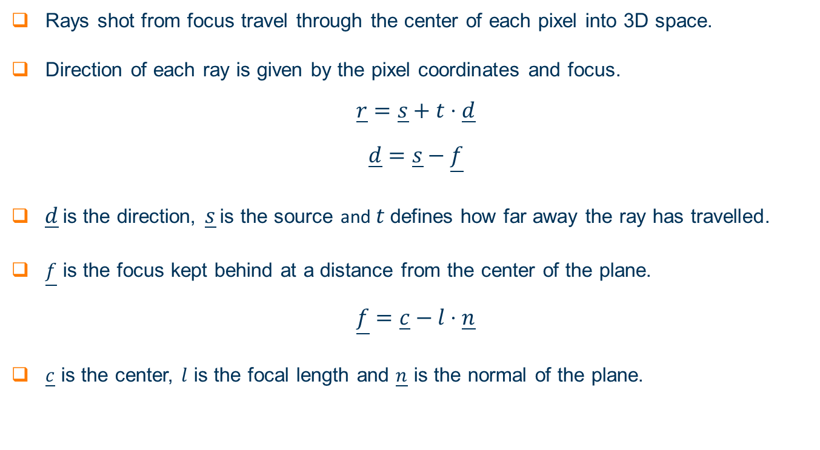
Ray Tracer Model
Rays shot from focus travel through the center of each pixel into 3D space.
Direction of each ray is given by the pixel coordinates and focus.
$$\underline{r}=\underline{s}+t⋅\underline{d}$$
$$\underline{d}=\underline{s}−\underline{f}$$
$\underline{d}$ is the direction, $\underline{s}$ is the source and $t$ defines how far away the ray has travelled.
$\underline{f}$ is the focus kept behind at a distance from the center of the plane.
$$\underline{f}=\underline{c}−l⋅\underline{n}$$
$\underline{c}$ is the center, $l$ is the focal length and $\underline{n}$ is the normal of the plane.

Slide 33
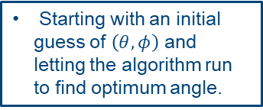
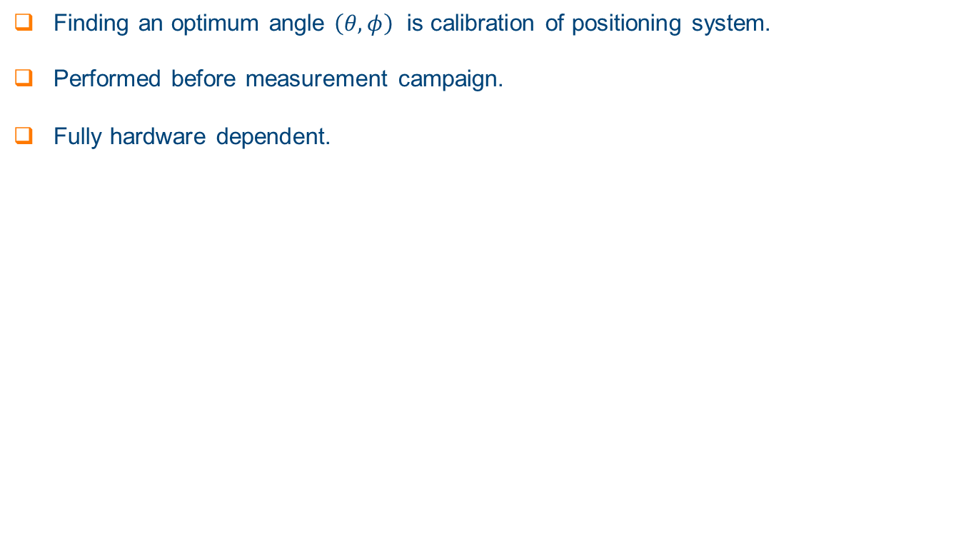
Problem Description
Finding an optimum angle $\left(θ,φ\right)$ is calibration of positioning system.
Performed before measurement campaign.
Fully hardware dependent.
Calibration of positioning system
Manual calibration
Stochastic Approximation
Taking measurements at each possible angle and calculating energy.
Starting with an initial guess of $\left(θ,φ\right)$ and letting the algorithm run to find optimum angle.

Slide 34
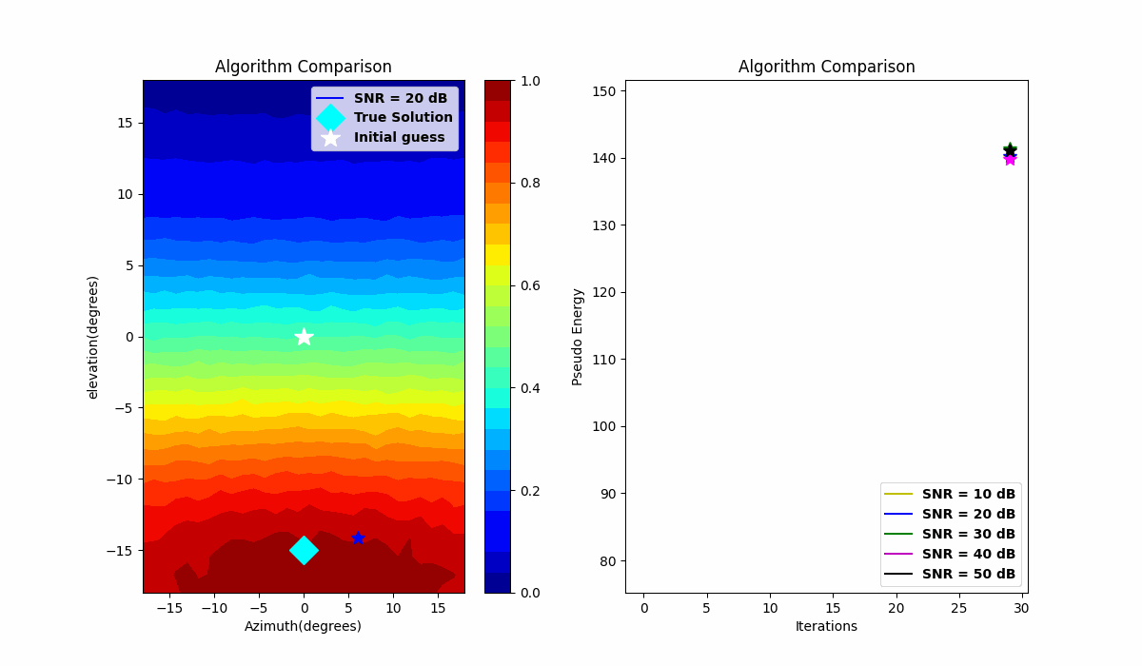
SPSA

Slide 35
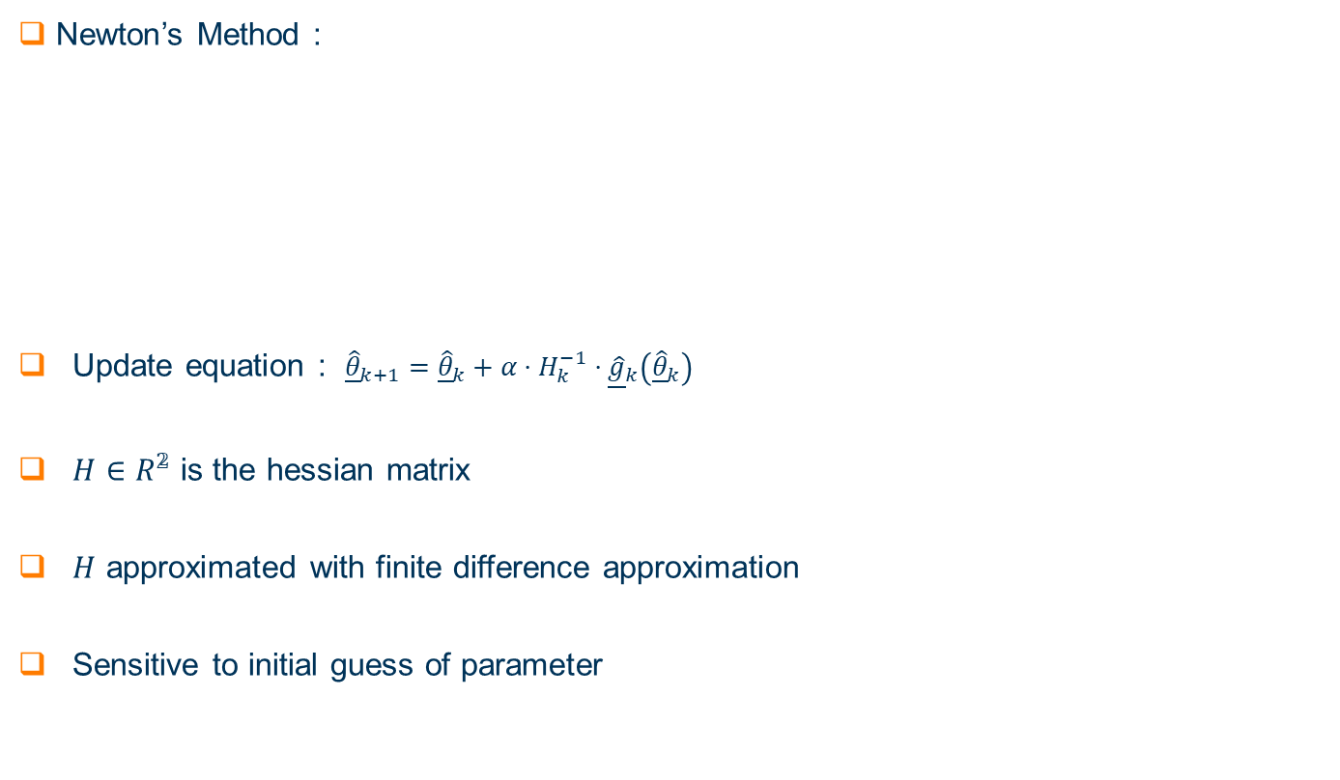
Stochastic Approximation : Newton’s Method
Newton’s Method :
Update equation : ${\underline{\hat{θ}}}_{k+1}={\underline{\hat{θ}}}_{k}+α⋅H_{k}^{−1}⋅{\underline{\hat{g}}}_{k}\left({\underline{\hat{θ}}}_{k}\right)$
$H∈R^{𝟚}$ is the hessian matrix
$H$ approximated with finite difference approximation
Sensitive to initial guess of parameter
Parameters | Details
Function Evaluations per Iteration | For current application 9 function evaluations are required.
Factors affecting convergence | The initial guess is often chosen closer to the true solution

Slide 36

Stochastic Approximation : Newton’s Method
Sensitivity to initial guess is tested
Sensitive to initial guess
Possibility of divergence
Parameter | Value
Step size | 0.05
SNR | 20 dB
Iterations | 30

Slide 37
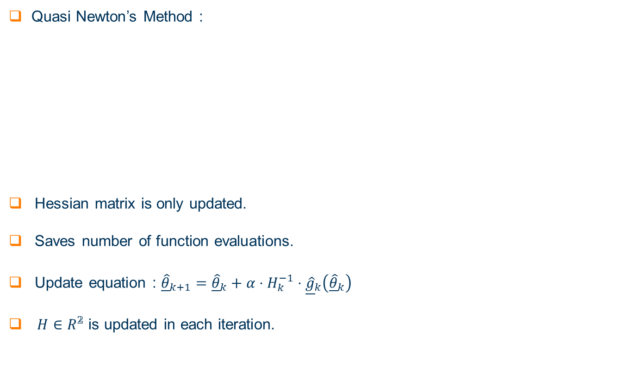
Stochastic Approximation : Quasi Newton’s Method
Quasi Newton’s Method :
Hessian matrix is only updated.
Saves number of function evaluations.
Update equation : ${\underline{\hat{θ}}}_{k+1}={\underline{\hat{θ}}}_{k}+α⋅H_{k}^{−1}⋅{\underline{\hat{g}}}_{k}\left({\underline{\hat{θ}}}_{k}\right)$
$H∈R^{𝟚}$ is updated in each iteration.
Parameter | Details
Function Evaluations per Iteration | Same as Gradient Ascent
Factors affecting convergence | Scaling factor used while initialization of hessian matrix with an identity matrix.

Slide 38

Stochastic Approximation : Quasi Newton’s Method
Using different scaling factors algorithm is tested
Increase in scaling factor reduces rate of convergence
Parameter | Value
SNR | 20 dB
Step size | 0.05
Initial guess azimuth | 0
Initial guess elevation | 0
Iterations | 30

Slide 39
SPSA 20 dB animation

Slide 40
Calibration Framework
Combines ray tracer and calibration algorithms.
Programmability of parameters and Less dependency on Hardware.
Faster testing of calibration methods.
Calibration Framework
Input arguments
Ray Tracer Model
Calibration Algorithms
Amplitude Scan
Initialize hardware setup
Configure transducer parameters.
Take the measurement based on input arguments
Initialize algorithm parameters
Use the measurement interface with required set of arguments
Collect and process measurement.

